Slide 1

Stock Price Prediction(HBL)
Presented by Muhammad Ali

Slide 2


The Data Foundation
Daily OHLC Data (2018–2025)
Our predictive model is built upon comprehensive historical data for Habib Bank Limited (HBL).
Dataset gathered from :

Slide 3

Algorithm of Choice: Facebook Prophet
Features
Open-source time series forecasting tool by Facebook (Meta).
Easy of use through installed package with:
pip install prophet
Handles Trend & Seasonality
Designed to capture complex patterns like daily, weekly, and yearly seasonality, crucial for stock market dynamics.
Optimized for Daily Data
Its additive model proves effective for high-frequency financial data, providing reliable predictions.

Slide 4


Alternative Approaches:
ARIMA (AutoRegressive Integrated Moving Average)
LSTM Neural Network (Deep Learning)
A classical statistical method for time series forecasting, suitable for data with identifiable patterns.
Long Short-Term Memory networks excel at learning long-term dependencies in sequential data, promising higher accuracy for complex patterns.

Slide 5
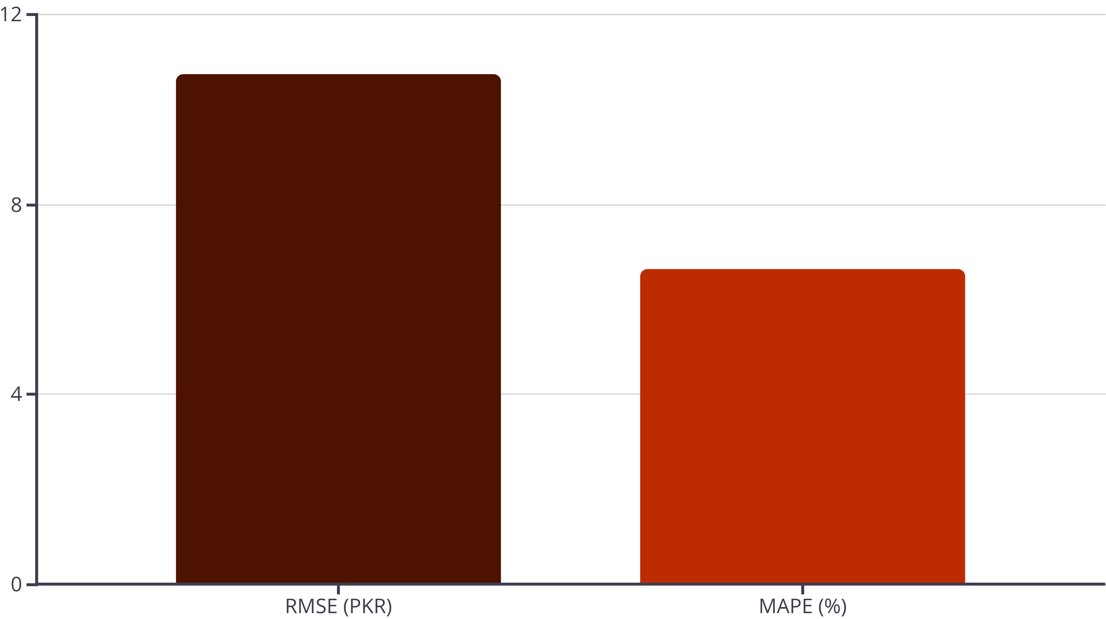
Model Performance: Quantifying Accuracy
Our Prophet model demonstrated strong performance on the training data, providing actionable insights into prediction reliability.
RMSE (~10.75 PKR): Indicates the average magnitude of the errors, in the same units as the stock price.
MAPE (~6.64%): Represents the average absolute percentage error, providing a relative measure of prediction accuracy.

Slide 6
Enhancing Prediction Accuracy: Beyond Price
To further refine our model's foresight, integrating diverse data streams is crucial. The current model was trained solely on daily closing rates.
Volume & Technical Indicators
Macroeconomic Data
Company Financials
Interest rates, inflation, and GDP growth significantly influence market sentiment and stock valuations.
Quarterly earnings, dividends, and debt levels offer direct insights into a company's health and future prospects.
Trading volume confirms trend strength, how much equity is being traded.
News & Sentiment Analysis
Technical Indicators
Peer Stock Prices
Leveraging natural language processing to gauge market sentiment from news articles and social media.
Moving Averages
Analyzing the performance of related banking sector stocks can reveal correlated movements and broader industry trends.
RSI
MACD

Slide 7




Thank you!

